Slide 1
Development of Contactless Fuel Payment Card System
Prepared by:
Iradukunda Denyse
Course:
DPR400210 – Programming Database with Oracle Database

Slide 2
Introduction
Fuel stations need fast and secure payment methods. Traditional cash payments can cause delays and poor transaction management.
This project develops a Contactless Fuel Payment Card System that allows customers to pay for fuel using a card and stores transaction information securely.

Slide 3
Problem Statement Many fuel stations face challenges such as: . Long waiting time during payment . Poor tracking of fuel transactions . Security problems caused by cash handling Difficulty managing customer payment records Solution. A database system that manages contactless fuel card payments securely

Slide 4
Project Objectives:
The system aims to:
Store customer information
Manage contactless payment cards
Process fuel payments
Record fuel transactions
Provide auditing and security control
Improve payment speed and accuracy

Slide 5
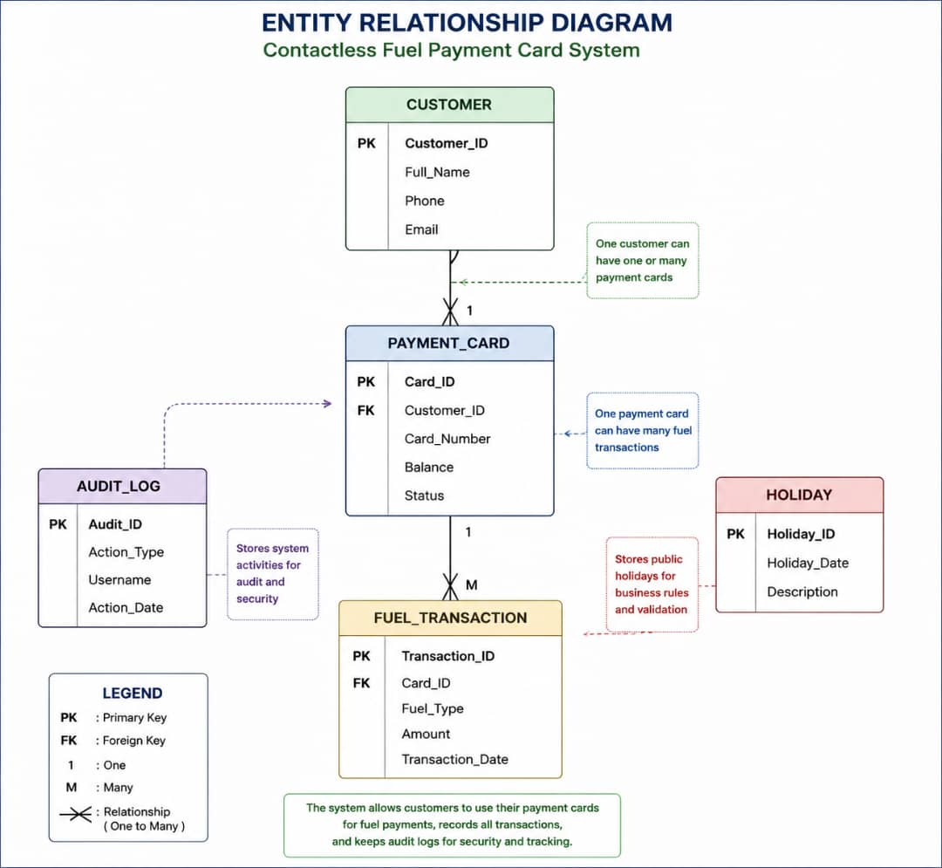
Database design;

Slide 6
Database Security
Implemented triggers:
1. Audit Trigger
> Automatically records payment activit >Tracks username and date
2. Restriction Trigger
> Applies business rules
> Controls INSERT, UPDATE, DELETE operations
. Security benefits:
> Data protection
> User activity tracking

Slide 7
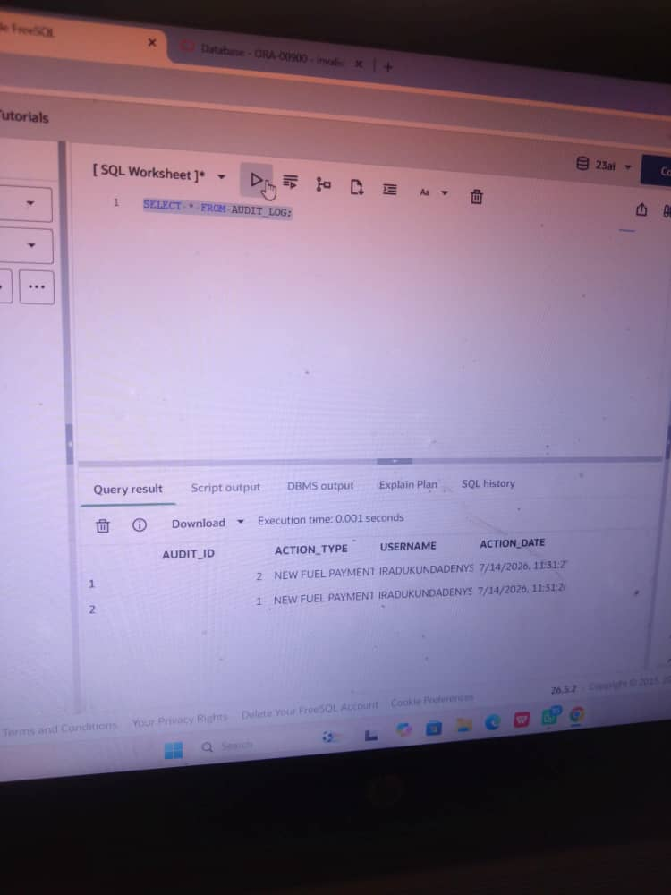
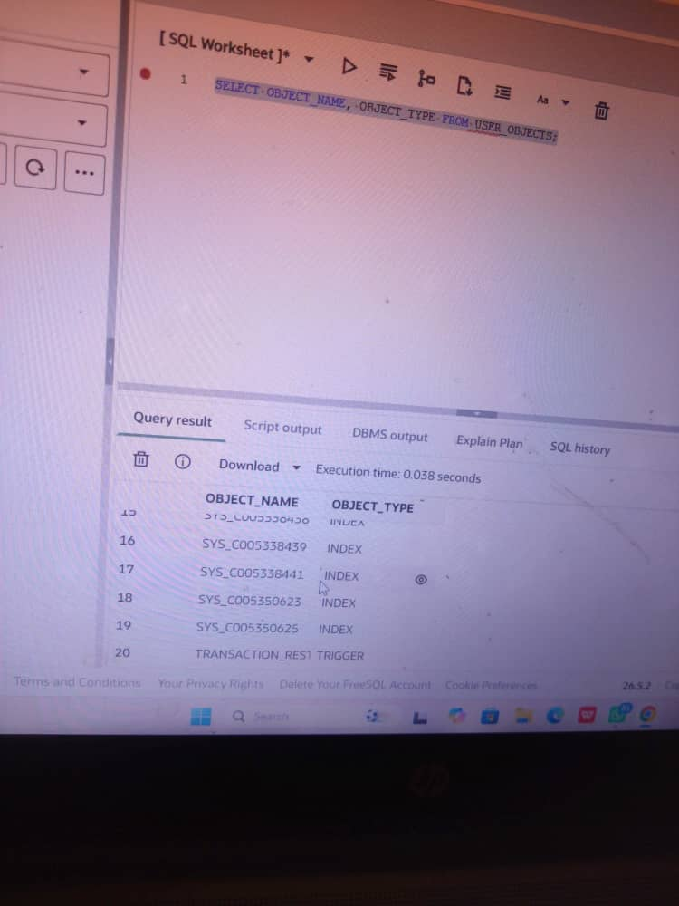
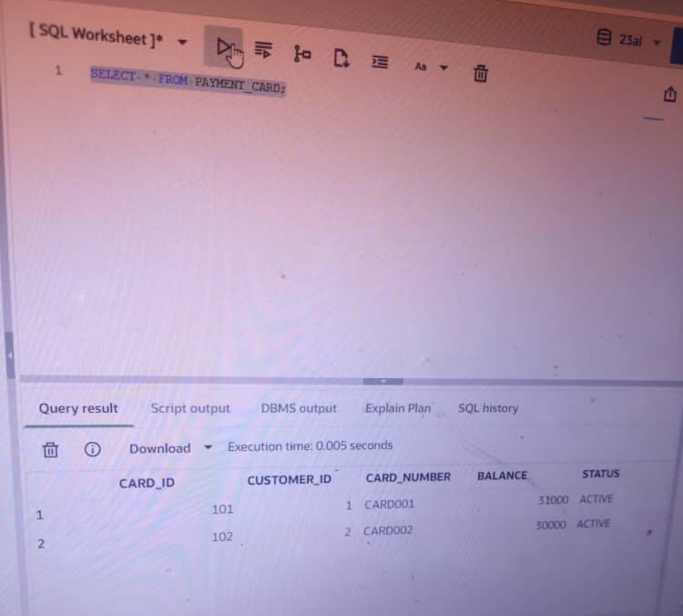
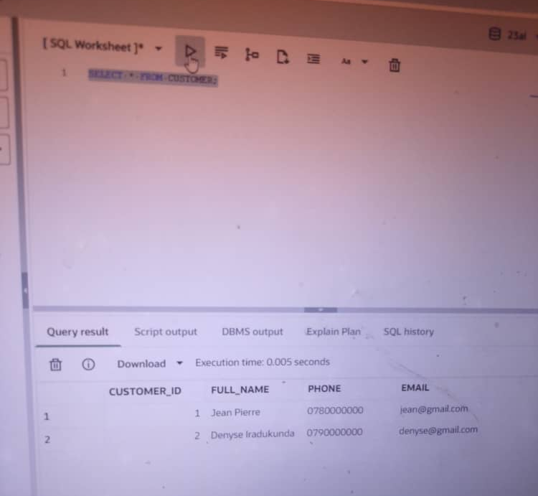
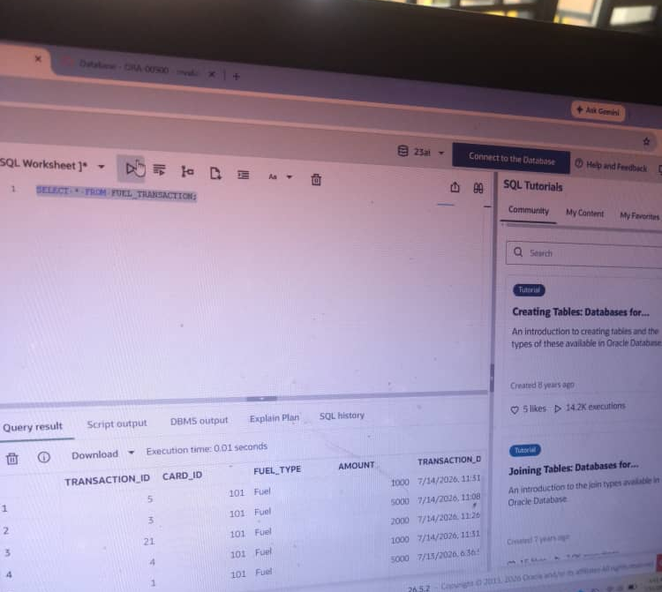
System Results
The system successfully:
✓ Creates database tables
✓ Processes fuel payments
✓ Updates card balance
✓ Stores transactions
✓ Records audit information
Demonstration:
Execute MAKE_PAYMENT procedure
Display transaction records
Display audit records

Slide 8
CUSTOMER
|
PAYMENT_CARD
|
FUEL_TRANSACTION
AUDIT_LOG
HOLIDAY

Slide 9
Database Implementation Show:
Tables:
- CUSTOMER
- PAYMENT
_CARD
- FUEL
_TRANSACTION
- AUDIT
_LOG
- HOLIDAY

Slide 10
Database Implementation
Show:
Tables:
- CUSTOMER
- PAYMENT_CARD
- FUEL_TRANSACTION
- AUDIT_LOG
- HOLIDAY

